Slide 1
Synthetic Dyes

Slide 2
Syllabus
Colour and Constitution [electronic concept], classification of dyes. Chemistry and synthesis of methyl orange, congo red, malachite green, crystal violet, phenolphthalein, fluorescein, alizarin and indigo.

Slide 3
What is a dye?
A dye is a substance which is used for imparting colour to fabrics in such a manner that the colour cannot be removed by rubbing or washing.
A substance can act as a dye if it satisfies following conditions :
It must have a suitable colour.
It must of capable of being fixed to the material being dyed.
Once fixed, it must be resistant to the action of light, water, soap and solvents used in dry cleaning.

Slide 4
Synthetic dyes
The dyes which are prepared synthetically in the laboratory are known as synthetic dyes.
These are also known as Coal-tar dyes.

Slide 5
Colour
Colour may be defined as the psychological sensation produced when the rays of visible range approach to the eye.
Sensation of Colour : White light is a combination of light of all wavelengths, which fall in the visible range. Different substances around us have different colour because they absorb and reflect different wavelength from the white light that falls on them.
A substance which totally reflects white light appears white.
A substance which absorbs all the wavelengths of white light appears black.
A substance which reflects a narrow band of wavelength of one colour and absorbs all other wavelengths has the colour of reflected light.
A substance which absorbs a single narrow band of one particular colour and reflects the remaining wavelengths has the colour due to the combination of remaining wavelengths. In such cases, the colour observed is said to be the complementary colour of the absorbed band.

Slide 6
Colour & Constitution : Electronic Concept
All the substances are capable of absorbing radiant energy of certain characteristic wavelengths depending upon their structure and various energy states in which the electron may exist. If the absorption takes place in visible region, the substance will be coloured. But if the absorption takes place in UV or Infra-red region, the substance will be appear to be colourless.

Slide 7
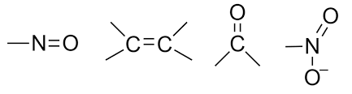
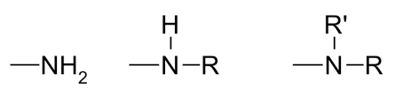
Classical Concept : Witt’s Theory
The main points of the Witt’s theory are :
The colour of a compound is mainly due to the presence of certain characteristic unsaturated group which are known as chromophores. Some important chromophores are :
Greater the no. of chromophores in a molecule, deeper is the colour.
Greater the no. of double bond in conjugation, deeper is the colour.
There are certain groups which themselves are not chromophores but deepen the colour, when chromophoric group is already present in a molecule. Such groups are called auxochromes.
For example :

Slide 8
Valence Bond Theory
According to this theory, the electron pairs of a molecule in ground state are in state of oscillation. When such molecules are placed in light, they absorb photons of appropriate energy and gets excite. The energy absorbed is equal to the difference in energy between ground state and the excited state. Smaller the difference in energy, longer is the wavelength of light. When this wavelength of light is sufficiently long to be in visible region, the compound begin to exhibit colour.

Slide 9
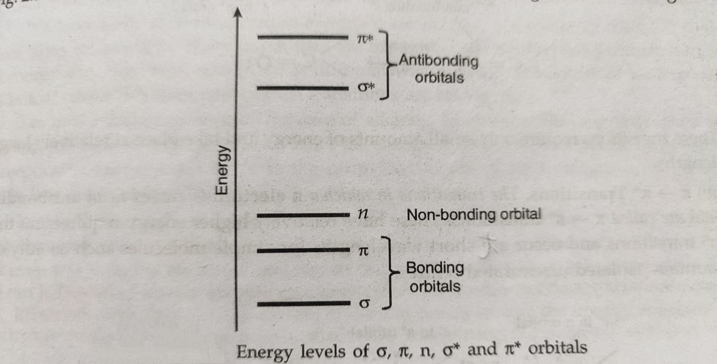
Molecular Orbital Theory
According to this theory, the electron present in a molecule in the ground state may be present in bonding, non-bonding and anti-bonding orbitals. The bonding orbitals may be σ orbital or π orbital. Similarly anti-bonding orbitals may be σ*orbital or π* orbital. When a beam of light falls on molecule, it absorbs a photon of light and the electron gets transferred from bonding or non-bonding orbital to an anti-bonding orbitals.
The energy of different molecular orbitals are shown below :

Slide 10
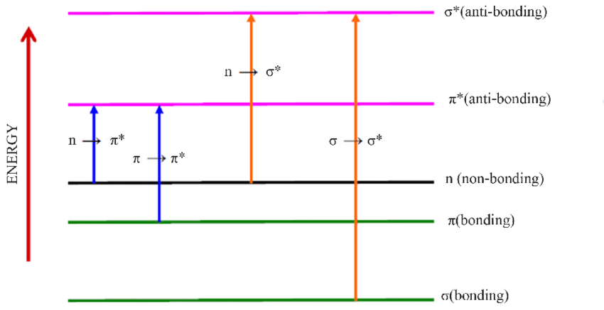
Electronic Transition
It involves the promotion of one electron from one orbital to another orbital of higher energy.
Different types of electronic transitions are shown below :

Slide 11
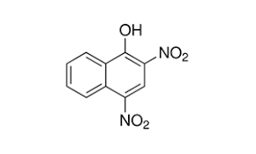
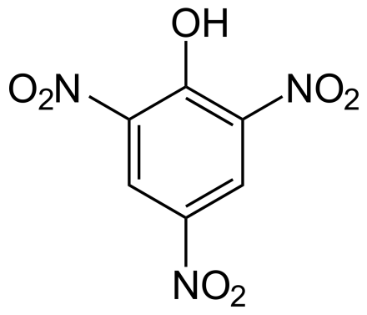
Classification of dyes on the basis of chemical constitution
Nitro dyes :These dyes contain nitro groups (-NO2) usually in ortho- or para- position to phenolic group.
Picric Acid Martius Yellow

Slide 12
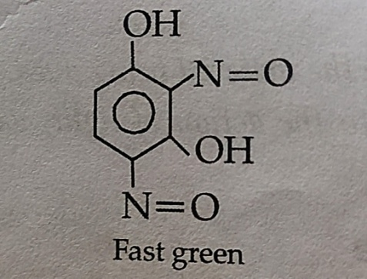
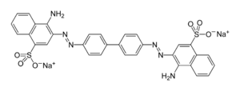
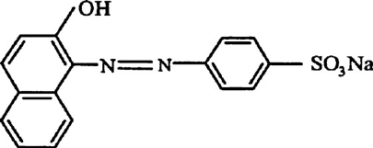
2. Nitroso dyes : These dyes contain nitroso groups (-NO) usually in ortho- or para- position to phenolic group.
3. Azo dyes : These dyes contains one or more azo groups(-N=N-) and constitute the largest and most important group of dyes.
The dyes containing one azo group is known as monazo.
The dyes containing two azo group is known as diasazo and so on.
Orange II (monazo) Congo red (diaszo)

Slide 13
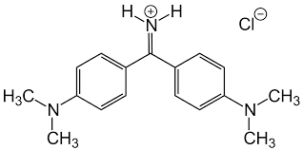
4. Diphenylmethane dyes : These are the derivatives of diphenylmethane, (C6H5)2CH2. An important example of such dye is Auramine-O.
5. Triphenylmethane dyes : These are the derivatives of triphenylmethane, (C6H5)3CH in which -NH2 , -NR2 or –OH groups are introduced onto the rings. They are further divided into three types according, as they contain two amino groups, three amino groups or –OH groups. These three types are :

Slide 14
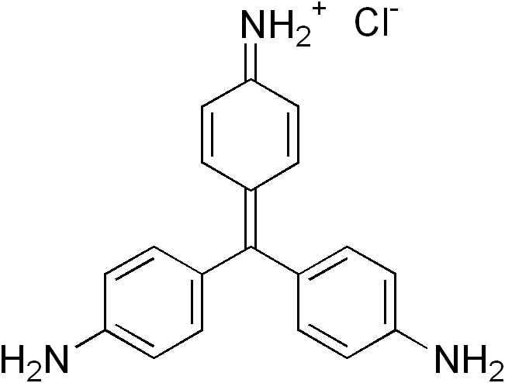
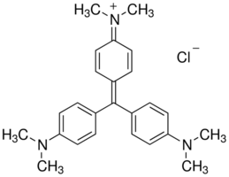
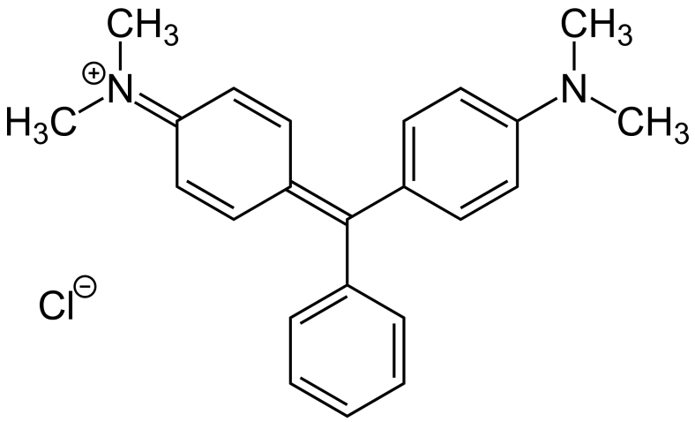
Rosaniline series : These are triphenylmethane dyes which contain three -NH2 or -NR2 groups.
Pararosaniline Crystal Violet
Malachite green series : These are triphenylmethane dyes which contain two -NH2 or -NR2 groups.
Malachite green

Slide 15
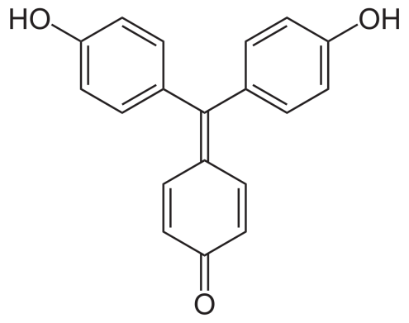
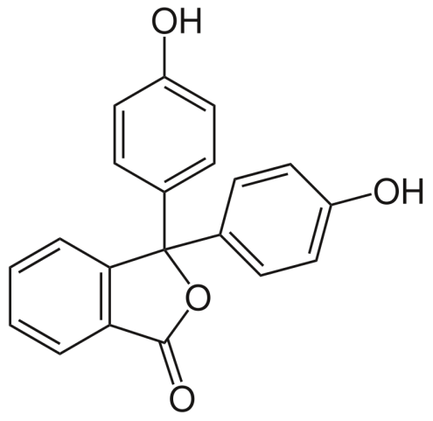
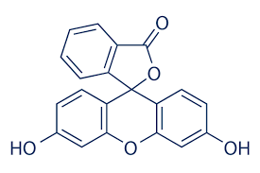
Rosolic acid series : These are triphenylmethane dyes which contain -OH groups.
Aurin
6. Phthalein dyes : This type of dye are obtained by heating phthalic anhydride with phenols in the presense of dehydrating agents such as ZnCl2 .
Phenolphthalein Fluorescein

Slide 16
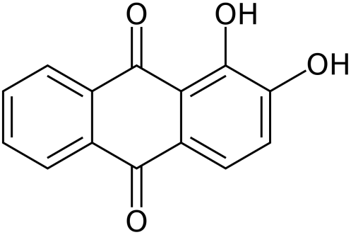
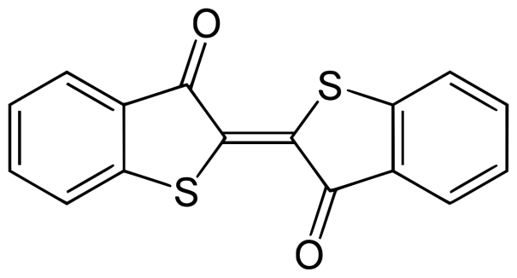
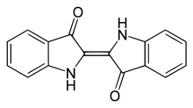
7. Anthraquinone dyes : These are the derivatives of anthraquinone.
Alizarine
8. Indigoids : It is a group of dyes which includes the oldest known naturally occurring dye indigo and its synthetically prepared modifications.
indigo thioindigo

Slide 17
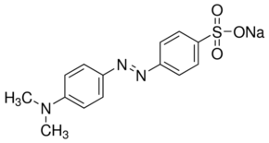
Classification of dyes on the basis of their mode of action
Acid dyes :These dyes are sodium salt of azo dyes containing sulphonic acid or carboxylic acid group which are applied to the fabric to form acidic solution. The dye binds to the fabric by the interaction of polar acidic group of the dye with the basic group of the fabric.
These dyes are used to dye wool, silk, acrylic fiber and nylon.
Methyl orange is one of the most commonly used acid dye.

Slide 18
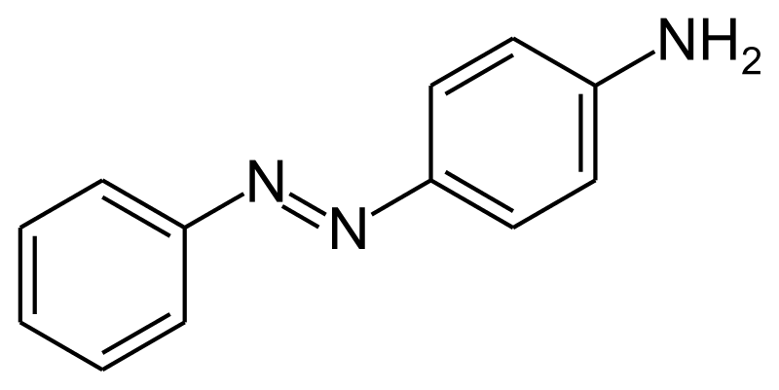
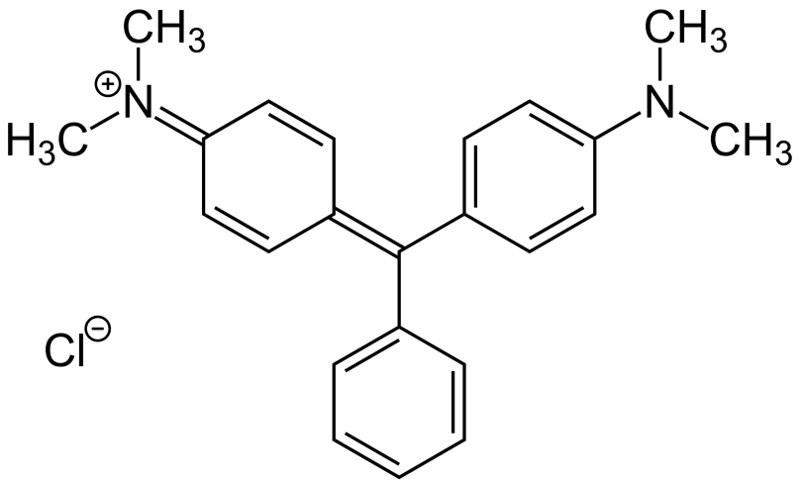
2. Basic dyes: These dyes are the salts of coloured bases containing amino or alkylaminno (-NH2 or -NR2 ) groups. These includes azo dye and triphenylmethane dyes.
In acidic solutions, the basic group of these dyes form water soluble cations which gets attached to the anionic sites present on the fabrics. These dyes are used to dye modified nylon and polyesters.
Aniline yellow and malachite green are common examples of basic dye.
Aniline yellow Malachite green

Slide 19
3. Direct or substantive dye : These are water soluble dyes which can be directly applied to the fabrics from aqueous solutions. These dyes are most suited for fabrics like cotton, rayon, wool, silk and nylon which forms hydrogen bonds with water.
Martius yellow and congo red are common examples of direct dye.
Martius yellow Congo red

Slide 20
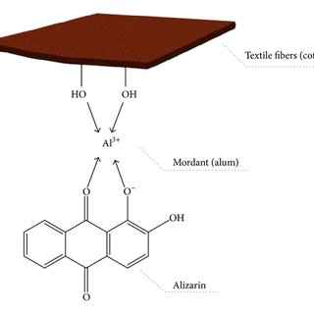
4. Mordant dye : These are the dyes which have no natural affinity for the fabric but requires the help of additional substance known as mordants. The mordants act as a binding agent between fabric and the dye.
For dying the fabric with mordant dye, the fabric is first soaked in a solution of soluble salt of the metal (i.e. mordant). The mordanted fabric is then placed in a solution of dye and insoluble coloured complexes called lakes are formed on the fabric. For example :

Slide 21
5. Vat dyes : These dyes are insoluble in water and therefore cannot be used directly for dyeing. They are first reduced to a colorless soluble from which is applied to the fiber and then oxidised back to the dye. They are mainly used for cotton cotton fabrics.
The dye is taken in large vats and treated with a reducing agent such as alkaline sodium hydrosulphite to a soluble compound. The fabric to be dyed is soaked in the solution of reduced dye and then treated with an oxidising agent such as perboric acid. As a result the colorless compound is reoxidized to the dye, which gets bound to the fabric.
Indigo is the most commonly used vat dyes.

Slide 22
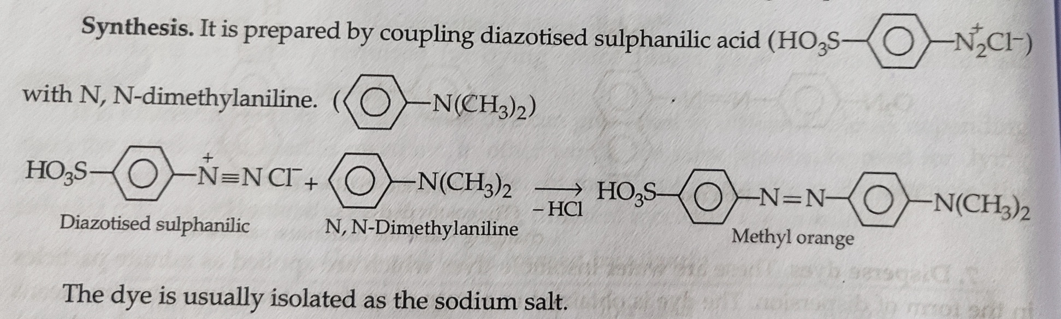
Methyl Orange
IUPAC Name : Sodium-p-dimethyl amino-azo benzene-p-sulphonate orange III
Methyl orange is simple example of a monazo acid dye. It is not sufficiently fast to light and soap to be used as a good dye.
It is widely used as an indicator in acid-base titrations due to colour change with the change in pH of the solution.
Synthesis :

Slide 23
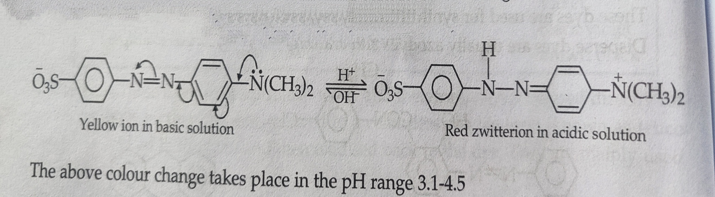
Methyl orange is used as an indicator in acid-base titrations because as the pH of the solution changes during titrations , methyl orange anion undergoes structural changes accompanied by change in colour.

Slide 24
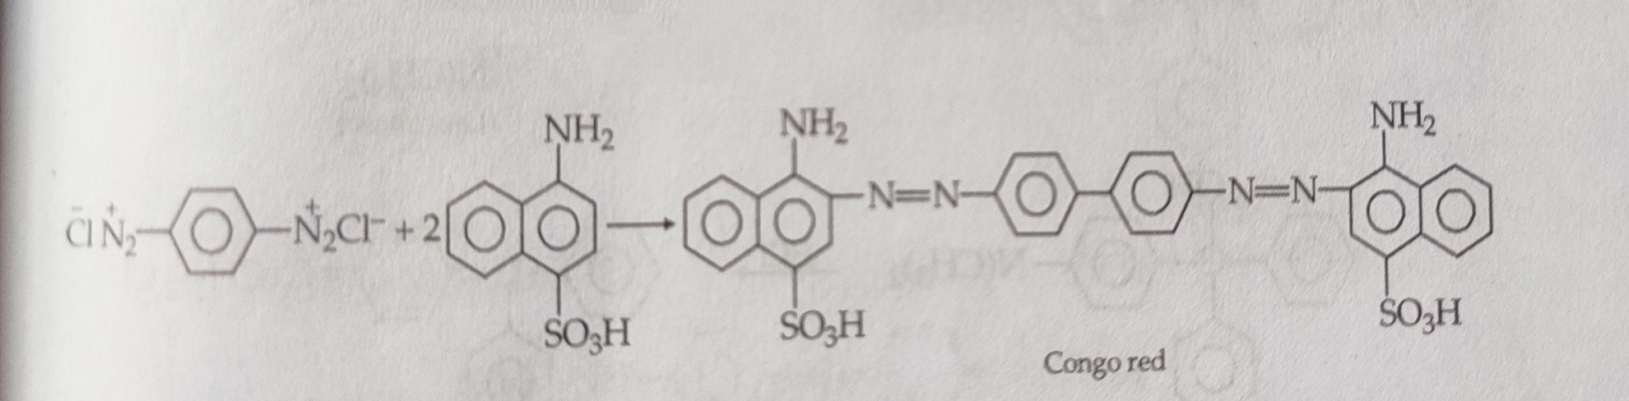
Congo Red
It is a diasazo acid dye. It is red in alkaline solution and its sodium salt is used for dyeing cotton directly.
Preparation : It is prepared by coupling tetrazotised benzidine with naphthionic acid.

Slide 25
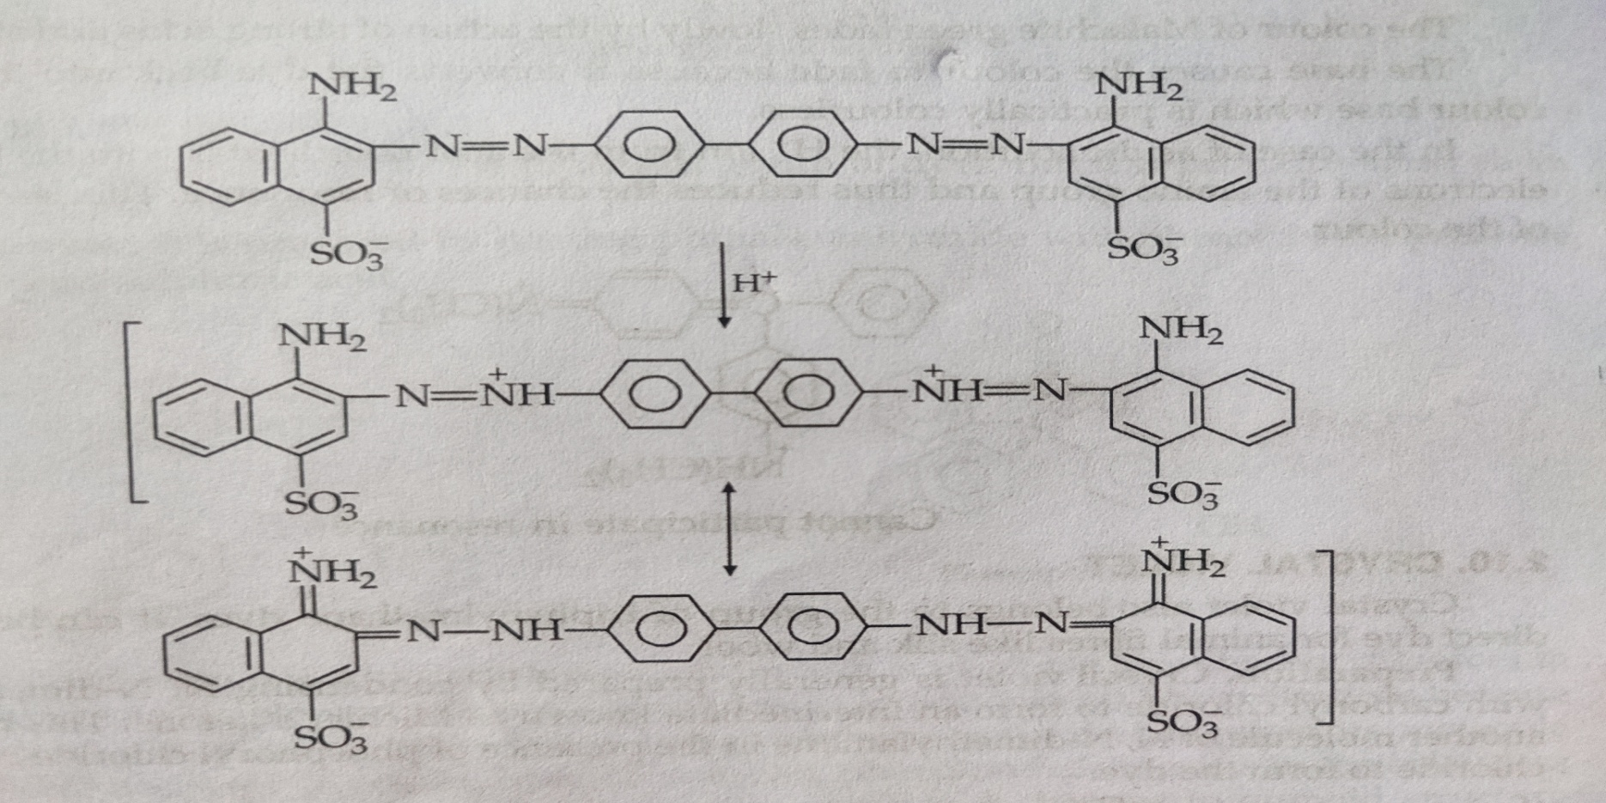
Congo red is very sensitive to acids and readily changes from red to blue in the presense of inorganic acid.
This can be explained in terms of resonance among the charged structure :

Slide 26
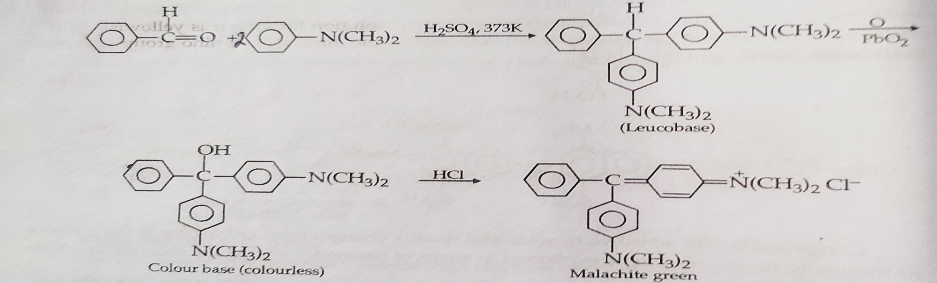
Malachite Green
It is a triphenylamine dye . It dyes cotton in the presense of tannin as mordant but is a direct dye for wool and silk.
Preparation : It is prepared by condensing benzaldehyde with 2 mole of N,N- dimethylaniline in the presense of concentrated H2SO4 at 373K. The triphenylmethane derivative thus produced is oxidized by PbO2 in solution of acetic acid containing HCl to form a color base. This is converted into malachite green with excess of HCl.

Slide 27
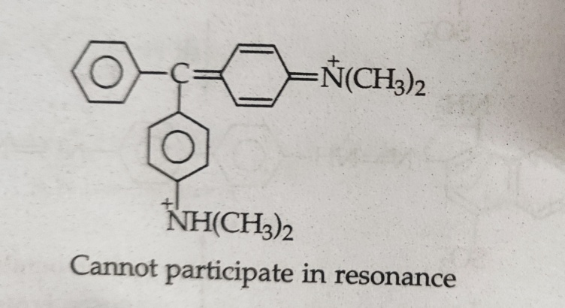
The color of malachite green faded slowly by the action of strong acids and strong bases.
The base causes the color to fade because it converts the dye back into the alcoholic color base, which is practically colorless.
In the case of acidic solution, the H+ ion from the acid co-ordinates with the lone pair of electron of the amino group and thus reduces the chances of resonance. This leads to fading of the color.

Slide 28
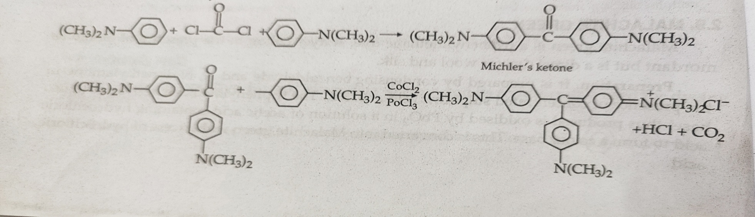
Crystal Violet
Crystal violet also belongs to the group of triphenylmethane dyes. It can be used as direct dye for animal fibers like silk and wool.
Preparation : It is generally prepared b condensing N,N- dimethylaniline with carbonyl chloride to form an intermediate known as Michler’s ketone. This reacts with another molecule of N,N- dimethylaniline in the presence of phosphoryl chloride to form the dye.

Slide 29
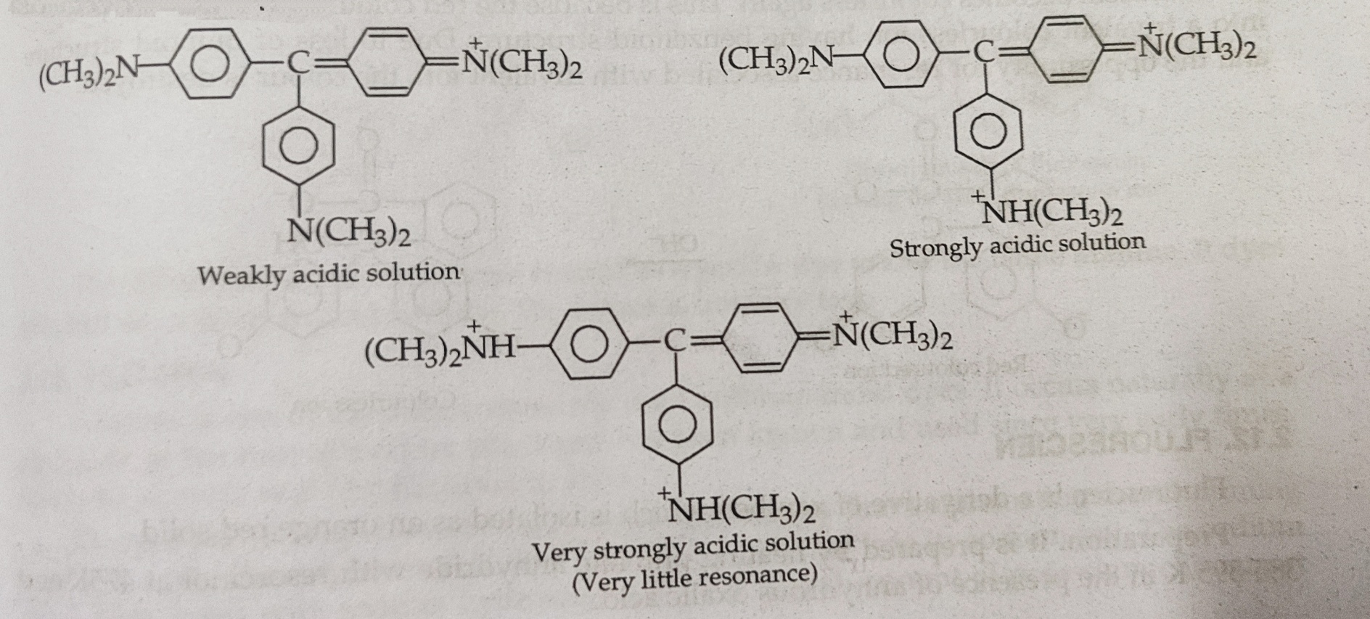
It has purple color in weakly acidic solution, green in strongly acidic solution and in even strong solution color is yellowish.
This is due to different opportunities of resonance as the nitrogen of amino group gets more and more protonated.

Slide 30
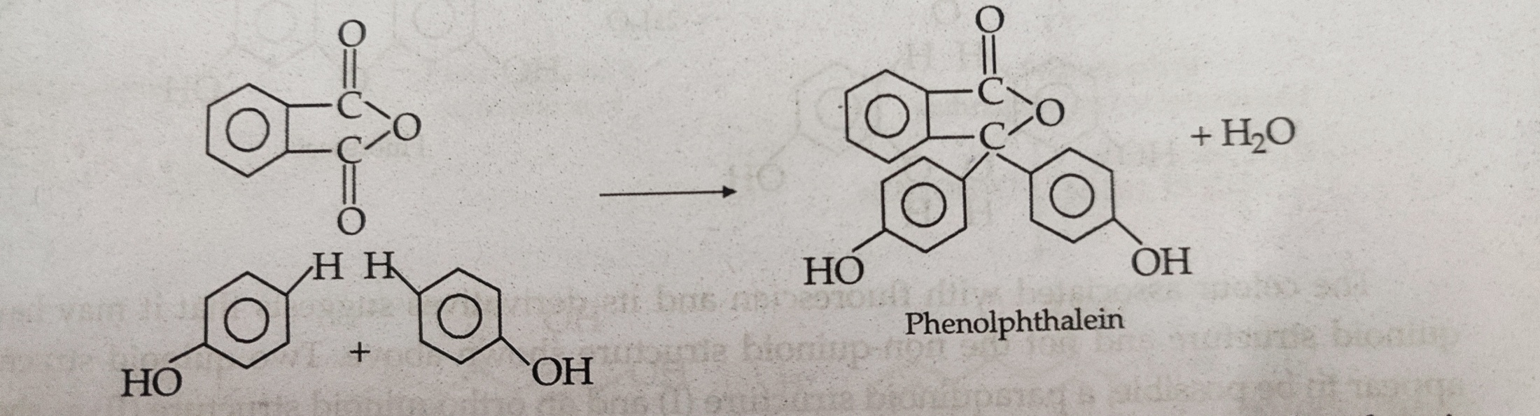
Phenolphthalein
Phenolphthalein belongs to the phthalein group of the dyes. But it is primarily used as an indicator rather than a dye.
Preparation : It is prepared by heating phthalic anhydride with phenol in the presence of concentrated H2SO4 or ZnCl2 .

Slide 31
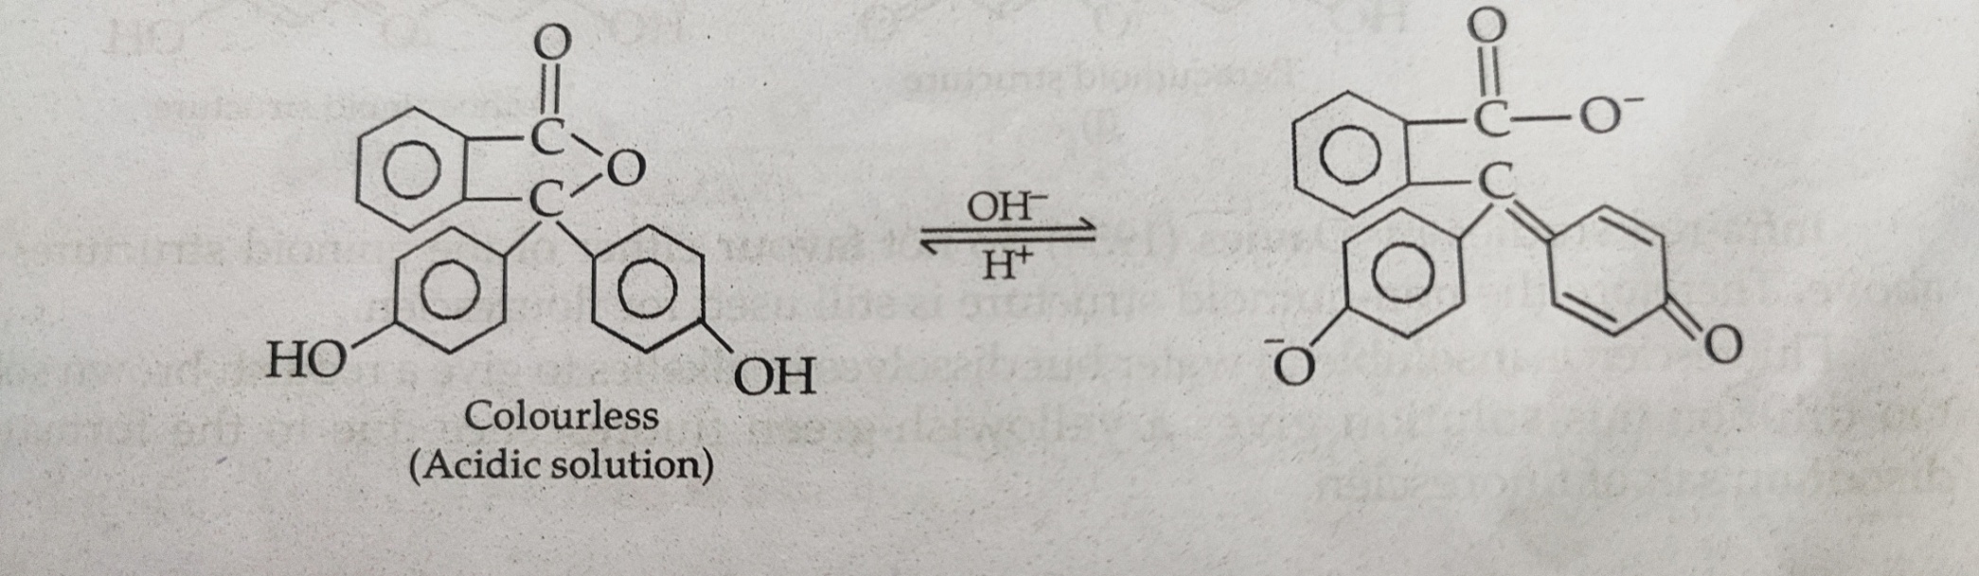
It is a white crystalline solid which is insoluble in water but dissolves in alkalies to form a red colored solution.
It is used as an indicator in acid-base titrations because the change in pH value of the solution brings the structural changes in its molecule accompanied by change in color.
In acidic solution ,phenolphthalein exists in the colorless form having benzenoid structure but in alkaline solution it changes to quinoid structure having red colored solution as shown below :

Slide 32
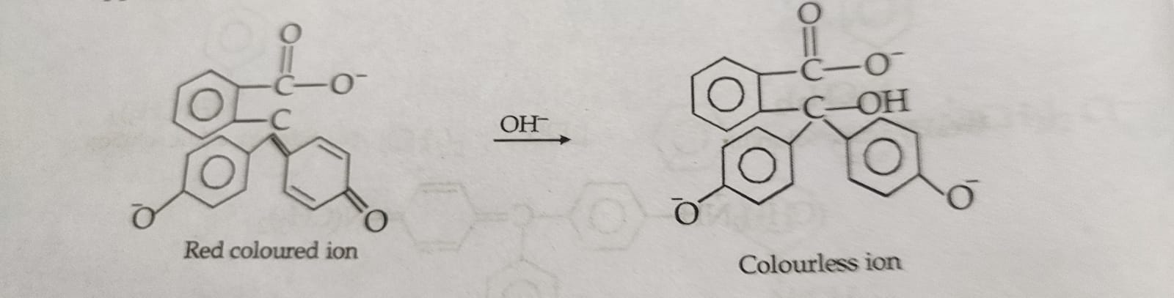
In the presence of excess of strong alkali, the solution of phenolphthalein becomes colorless again. This is because the red colored divalent ion changes into a trivalent colorless ion having benzenoid structure.

Slide 33
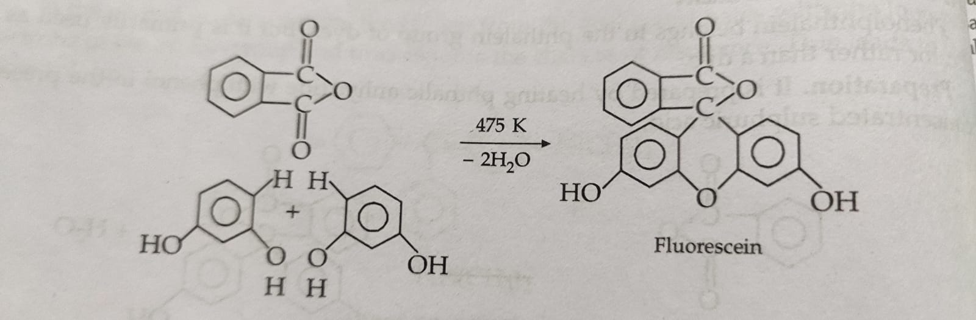
Fluorescein
Fluorescein is a derivative of xanthen which is isolated as an orange red solid.
Preparation : It is prepared by heating phthalic anhydride with resorcinol at 475K or at 385-395 K in the presence of concentrated H2SO4 or ZnCl2 .

Slide 34
Fluorescein is an orange solid, insoluble in water but dissolves in alkalies to give a reddish brown solution.
On dilution this solution gives a yellowish-green fluorescein due to the formation of disodium salt of fluorescein ions.
The disodium salt of fluorescein is used as a yellow dye under the name uranine. It dyes silk and wool from acid bath.

Slide 35
Alizarin
Alizarin is the one of the most commonly used anthraquinoid dye. It occurs naturally as a glucoside in the root of madder plant.
Preparation : It is prepared from anthraquinone by first sulphonating it with fuming sulphuric acid. The sulphonic acid thus formed is converted into its sodium salt . The sodium salt is then fused with NaOH and potassium chlorate (KClO3) at about 470K under pressure. The product thus formed on acidification with H2SO4 gives alizarin.

Slide 36
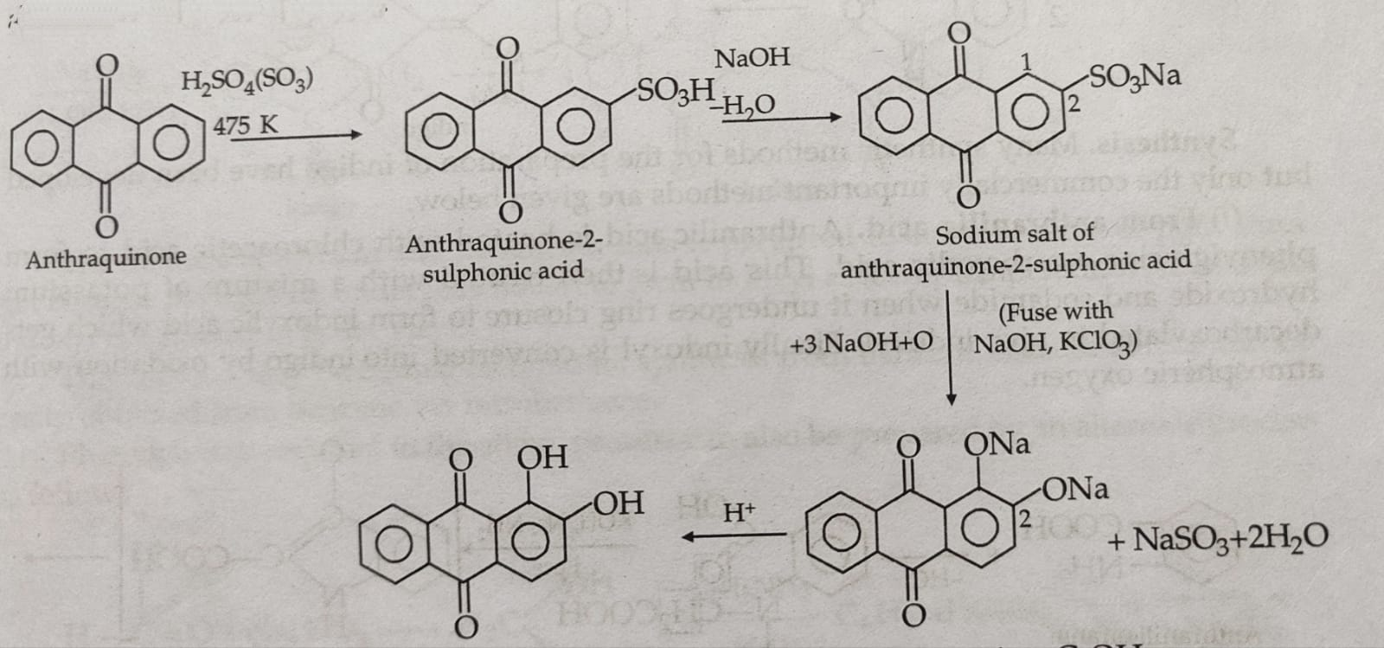
It is isolated as a red crystalline solid which dissolves in alkalies to form purple solution.
It is a mordant dye and forms lakes of different color depending upon the metal ion used as mordant.

Slide 37
Indigo
Natural indigo from the plants of the indigofera is the oldest known dye. It is not present as such in the plants but occurs in the form of indican.
Synthesis : (a) From Anthranillic acid :
Anthranillic acid is heated with chloroacetic acid to form phenylglycine-o-carboxylic acid. This acid is then treated with a mixture of potassium hydroxide and sodamide, and it undergoes ring closure to form to form indoxylic acid which gets decarboxylated to give indoxyl. Finally indoxyl is converted into indigo by oxidation with atmospheric oxygen.t

Slide 38
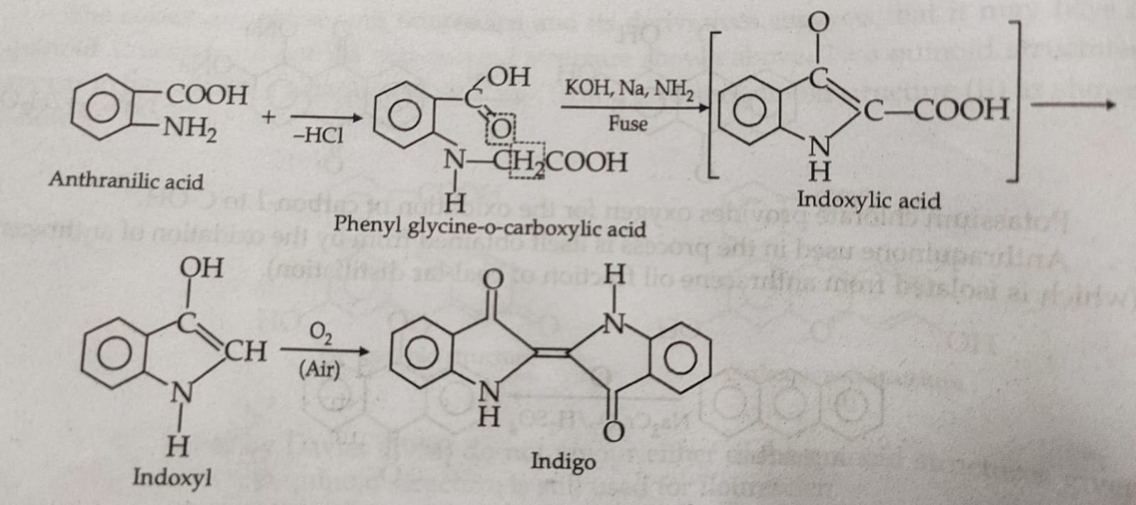

Slide 39
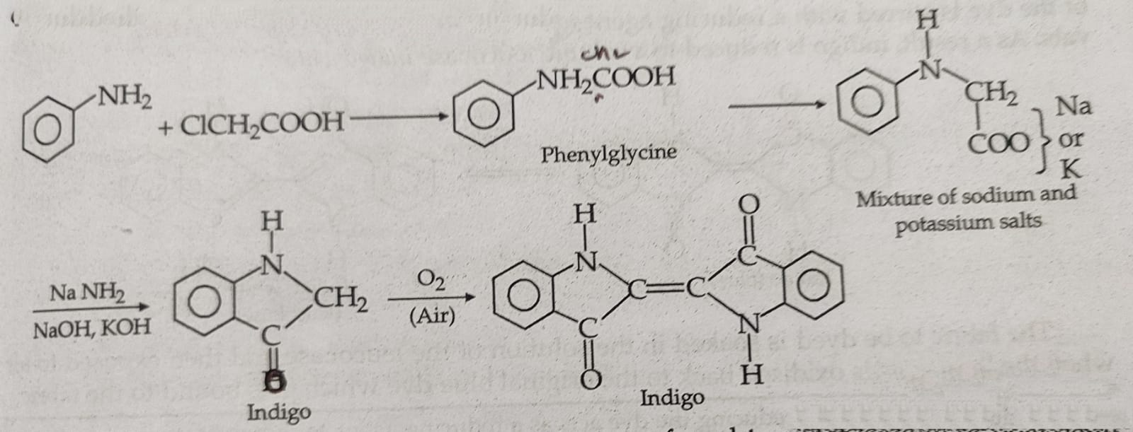
(b) From Aniline :
Aniline is heated with chloroacetic acid to form phenylglycine. This on treatment with NaOH and KOH gives a mixture of its sodium and potassium salts. This mixture undergoes ring closure on fusion with a mixture of sodamide , KOH and NaOH at 595-615K to form indoxyl. Indoxyl is then converted into indigo on exposure to air.

Slide 40
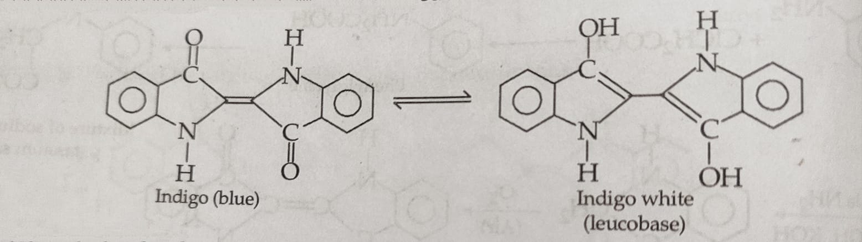
Indigo is a dark blue powder insoluble in water. For dyeing a fabric with indigo, a paste of the dye is stirred with a reducing agent such as sodium hydrosulphite in large vats. As a result indigo is reduced to soluble leucobase indigo white.
The fabric to be dyed is soaked in the solution of leucobase and them exposed to air. The leucobase is oxidized back to original blue dye which gets bound to fabric.

